Slide 1
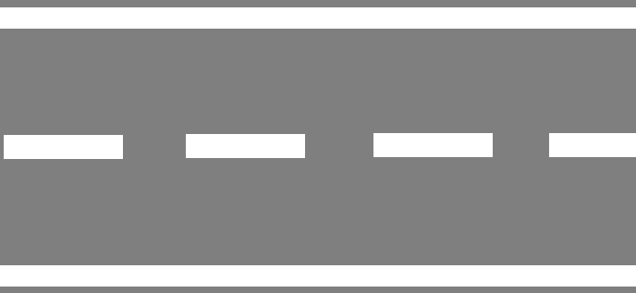
Road Lane
To implement TIE vehicle check a road should be of at least of two lanes. One for light vehicles like cars, jeep, etc and other for Heavy vehicles such as Trucks, Bus, etc.
If a road has single lane it can be Splitted into 2 at least at the barrier section as shown in diagram below
Heavy Vehicle
Light Vehicle
Checking Barriers
Light Vehicle
Heavy Vehicle

Slide 2
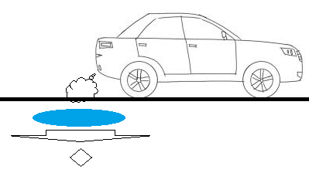
Pollution check
The Pollution check sensor will be placed under the road near the vehicle exhaust area
To make it effective following arrangement can be made
There will be a fan pulling the exhausted air of vehicle which is placed below the metal net.
This metal net will be parallel to road and will be placed on the surface of road
The air pulled by the fan will directly be thrown on the PUC Check sensor which then find the purity of air throw by any vehicle
Side view
Top view
Car
Pulling Fan
Pollution Check Sensor

Slide 3
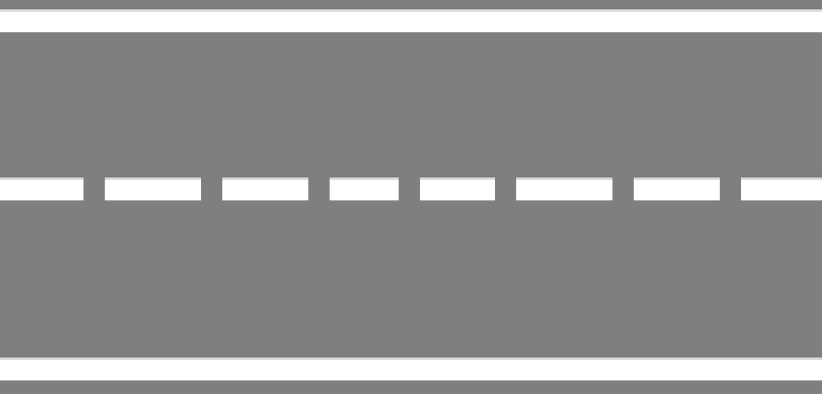
Finding Weight
Over weighted vehicle are not only illegal but they are also harmful on roads.
The weight is calculated on each wheel/axel (since sometimes the weight is not evenly distributed which could be harmful for particular axel).
Then the sum of all is calculated to find the total weight
Car
Car/Auto Lane
Auto

